Slide 1
Bienvenidos a espaÑol – 7th grade
Carolina Ayerbe

Slide 2
About the teacher
Born in caracas, Venezuela
Lived in Venezuela, spain, st. marten, and the united states (florida & Georgia)
ATTENDED UNIVERSITY OF SOUTH FLORIDA – B.A. IN COMMUNICATIONS (1995)
ATTENDED UNIVERSITY OF PHOENIX – M.A. IN ORGANIZATIONAL MANAGEMENT (2003)
ATTENDED FORT HAYS STATE UNIVERSITY – M.S. IN EDUCATIONAL LEADERSHIP (2014)

Slide 3
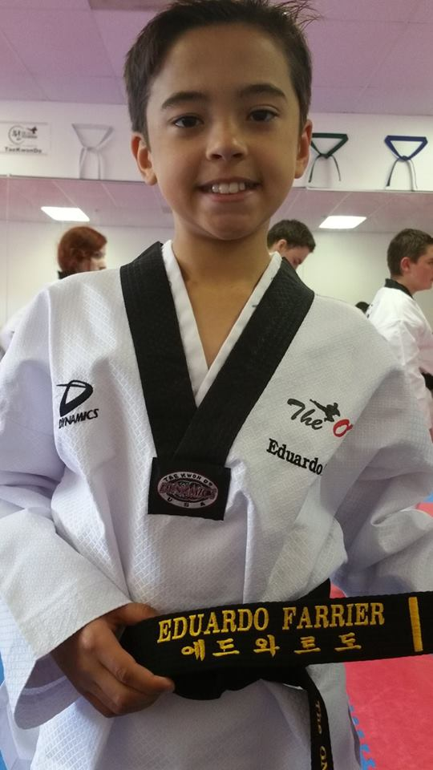
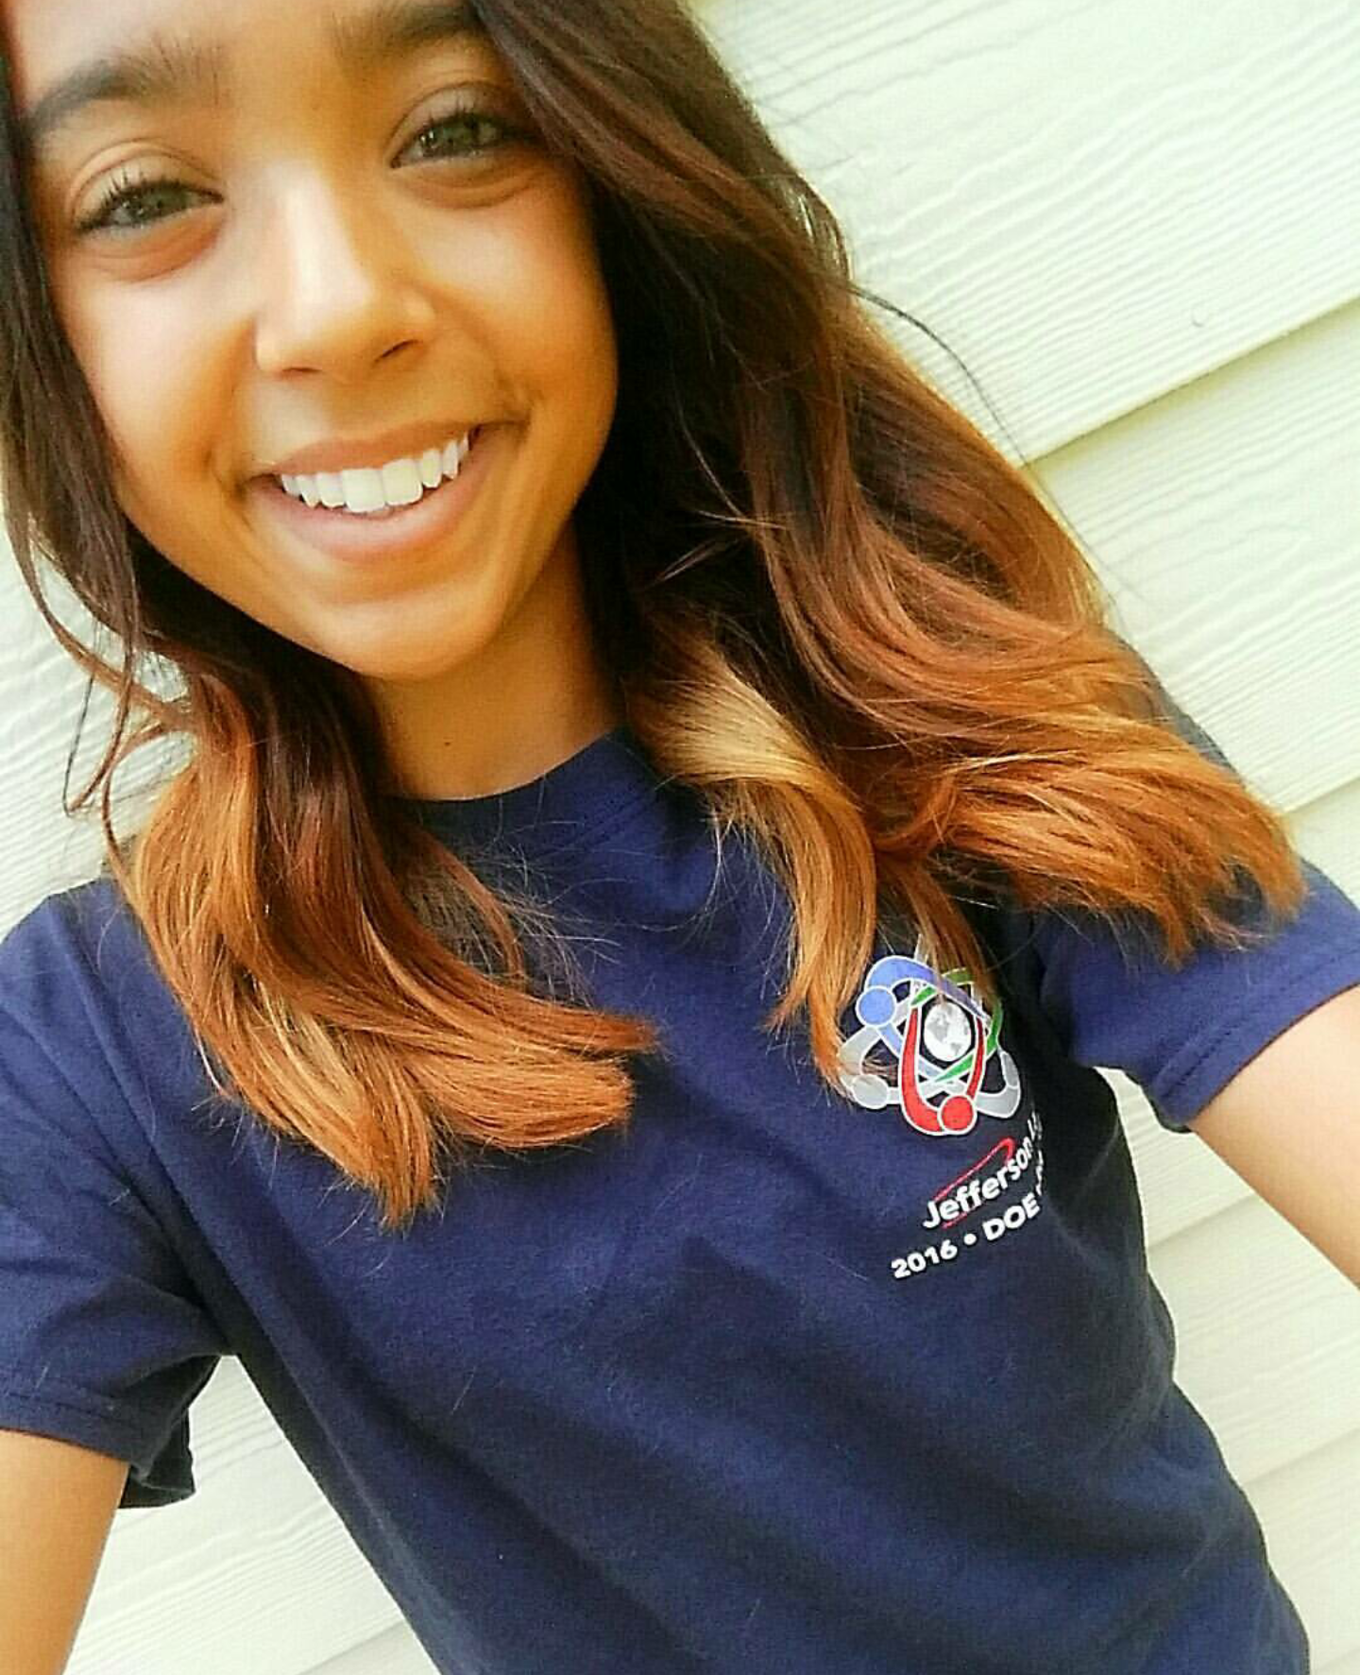
ABOUT THE TEACHER (MORE)
MARRIED FOR 18 YEARS
TWO KIDS, JULIA (15) – sophomore IN Woodstock high school & Eduardo (12) – 7th grader in Woodstock middle school
A dog (percy), a cat (gigi), and a bearded dragon (spikey)
13+ years of teaching experience (Spanish & HS SOCial Studies)

Slide 4
About the class
At the conclusion of both the grade seven and grade eight world language program, students will have completed the equivalent of the level one high school course and may be eligible for level two language study in grade nine.

Slide 5
About the class
First Semester | Second Semester
Hola. ¿Qué tal? – Lesson 1.1-1.4 | En la clase – Lesson 2.2-2.4
En la clase – Lesson 2.1 | La familia – Lesson 3.1-3.2

Slide 6
ABOUT THE GRADING
Summative: Tests and Projects: 20%
Summative: Performance Based Assessments: 30%
Formative: Quizzes: 15%
Formative: Class work: 5%
Formative: Participation: 10%
Homework: 5%
Summative: December Final: 15%
May Summative Final common Assessment (FCA): 15%

Slide 7
Class Participation
Students will be responsible for recording oral class participation on the Target Language Communication Log, to be kept at all times in their binder. Should this form be misplaced, a penalty will apply to the participation grade

Slide 8
HELP SESSION
Every MonDAY FROM 8:20 TO 8:45

Slide 9
COMMunication
My email is Ayerbec@fultonschools.org and my website is: Http://laclasedemrsc.Weebly.Com/
REMIND (text updates) text @ayerbe to 81010

Slide 10
SCHEDULE
6:00 pm – 6:20 pm FIRST PERIOD with Welcome Video
6:25 pm – 6:38 pm SECOND PERIOD
6:43 pm – 6:56 pm THIRD PERIOD
7:01 pm – 7:14 pm FOURTH PERIOD
7:19 pm – 7:32 pm FIFTH PERIOD
7:37 pm – 7:50 pm SIXTH PERIOD
7:55 pm – 8:08 pm SEVENTH PERIOD
8:13 pm – 8:26 pm EIGHTH PERIOD
8:30 pm DISMISSAL

